Slide 1
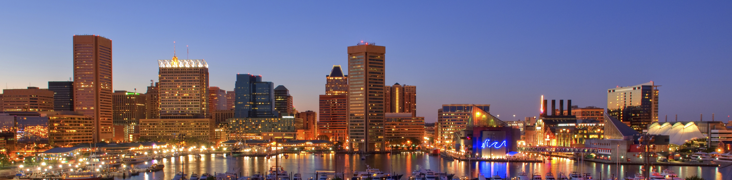

March 2024
BALTIMORE CHAPTER OF LAMBDA ALPHA INTERNATIONAL

Slide 2
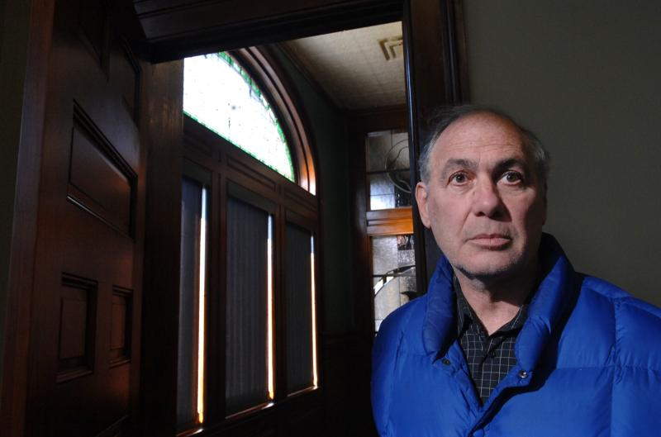
CHAPTER MEMBER NEWS
In Memoriam
STANLEY KEYSER
Keyser Development Corp.
LAI Baltimore Member since 2004

Slide 3
CHAPTER MEMBER NEWS
We welcome new member
CHRISTOPHER N. MURN
President
Murn Development, LLC

Slide 4
CHAPTER MEMBER NEWS
We welcome new member
KEITH GILLAN
President
Murn Managment, LLC

Slide 5
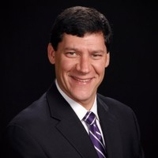
CHAPTER MEMBER NEWS
We welcome new Membership Committee member
KEN RICE
Managing Member
BlueStone Development, LLC

Slide 6
CHAPTER MEMBER NEWS
We appreciate all of our LAI members - and our connections - who
follow our chapter’s LinkedIn Page. If you haven’t yet, please do:
Lambda Alpha International - Baltimore Chapter
We currently have 363 followers.
[19 more since last month]
We post about LAI International, LAI Baltimore, Land Economics Foundation, and info about you - our members and our speakers -
such as awards, news, podcasts or journalistic columns, authored research or books, events, civic or nonprofit boards that you joined,
and other news you share with us.
Please share your news with us or on LinkedIn!

Slide 7
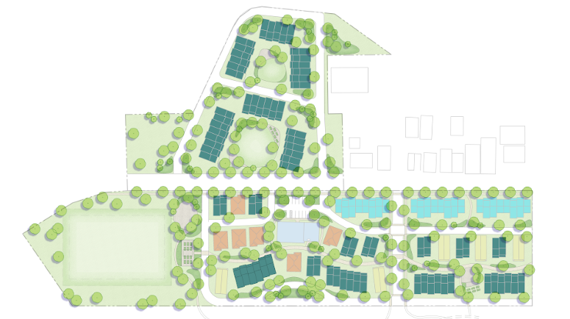
UPCOMING CHAPTER PROGRAMS
  Wednesday, April 17th, 12 Noon
Topic: Senior Housing Models
Speaker: Jane Rohde
Principal JSR Associates, Inc.
Venue: University of Maryland BioPark

Slide 8
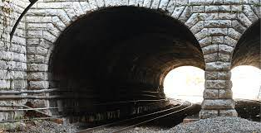
UPCOMING CHAPTER PROGRAMS
  Wednesday, May 15th, 12 Noon
Topic: Howard St Tunnel Redevelopment Project
Speaker: Brian Hammock
Executive Director
West North Avenue
Venue: Bio Park

Slide 9
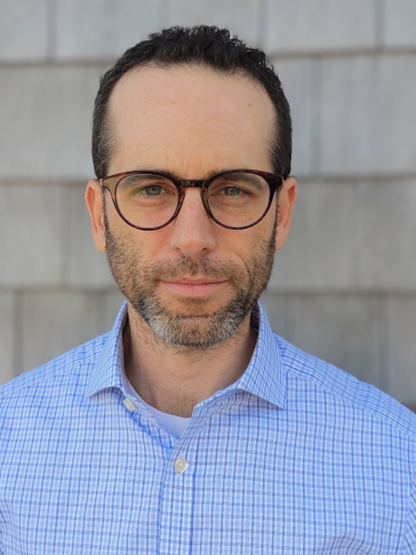
UPCOMING CHAPTER PROGRAMS
  Wednesday, June 19th, 12 Noon
Topic: EBDI
Speaker: Dr. Brett Theodos
Senior Fellow and Director of the
Community Economic Development Hub
Venue: University of Maryland BioPark

Slide 10
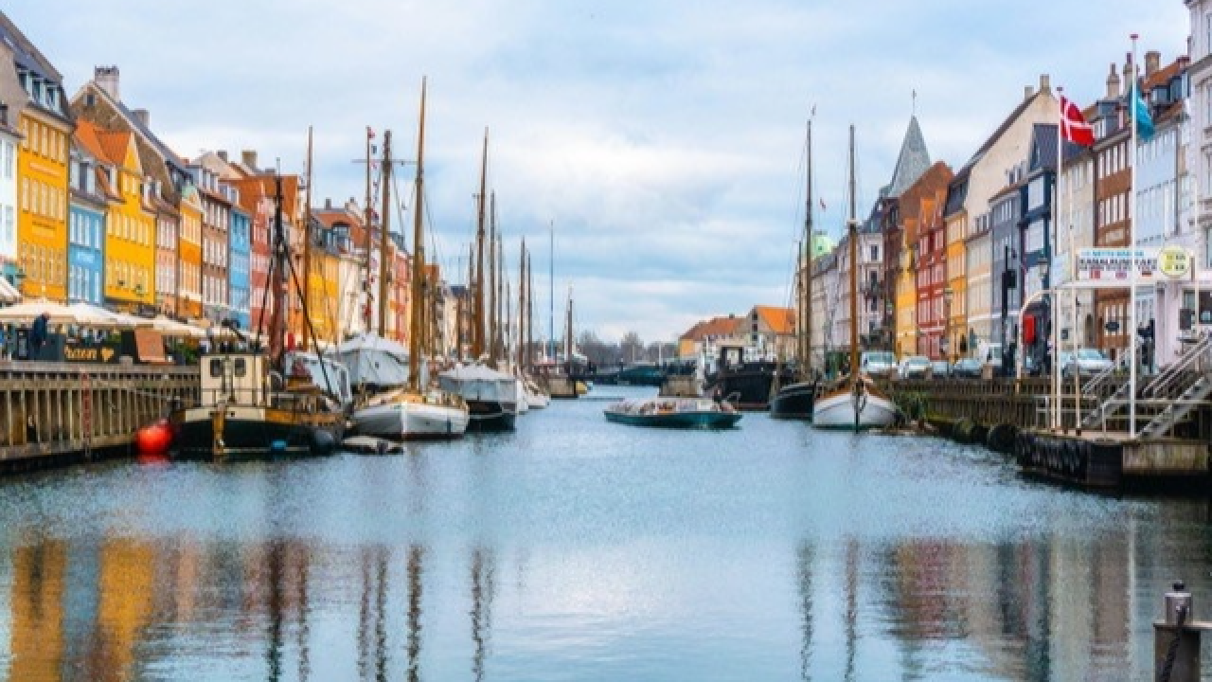
LAI REGIONAL STUDY TOUR: COPENHAGEN
A City in Transition
Join us!
The Transformation of Harbor and Former Industrial District
May 16 – 17, 2024
https://www.lai.org/events/2886

Slide 11
LAI REGIONAL STUDY TOUR: COPENHAGEN
A City in Transition
Join us!
The Transformation of Harbor and Former Industrial District
May 16 – 17, 2024
https://www.lai.org/events/2886

